Slide 1
US Visa Approval Prediction
Machine Learning Project

Slide 2
Project Overview:
Understanding the Problem Statement
Understanding the solution
Code understanding & walkthrough
Understanding the Deployment

Slide 3
Deployment:
Docker
Cloud Services
Adding self hosted runner
workflows

Slide 4
Problem Statement:
US visa approval status
Given certain set of feature such as ( continent, education, job_exprience, training, employment, current age etc.
We have to predict weather the application for the visa will be approved or not.

Slide 5
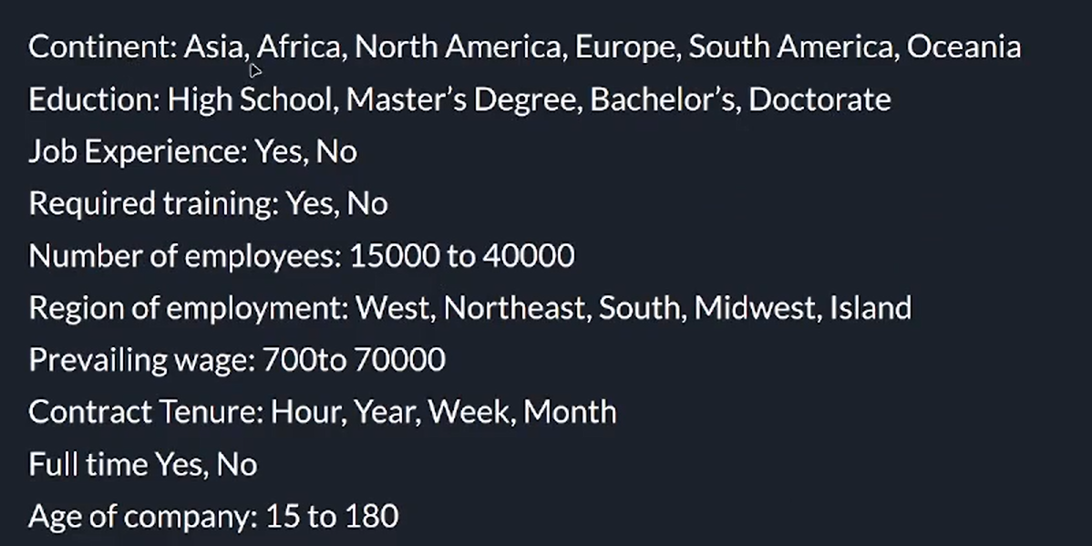
Features:

Slide 6
Solution Scope:
This can be used on real life by US visa applicants so that they can improve their
Resume and criteria for the approval process.

Slide 7
Solution Approach:
Machine learning : ML Classification Algorithms
Deep Learning: Custom ANN with sigmoid activation Function

Slide 8
Solution Proposed:
We will be using ML
Load the data from DB
Perform EDA and feature engineering to select the desirable features.
Fit the ML classification Algorithm and find out which one performs better.
Select top few and tune hyperparameters.
Select the best model based on desired metrics

Slide 9
Project Setup:
Github Repository
Requirements
Template

Slide 10

MongoDB setup
https://cloud.mongodb.com/

